Slide 1

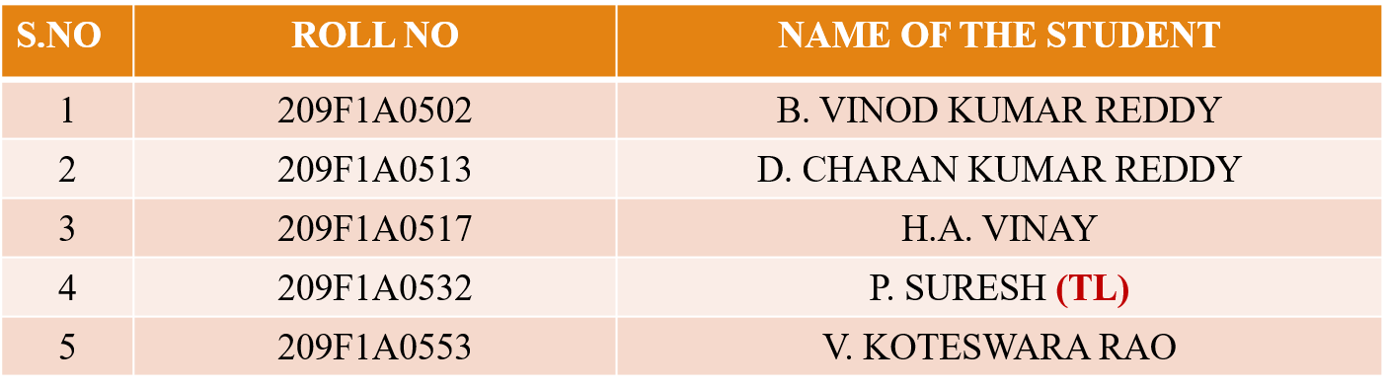
“Machine Learning Techniques for Estimating Forest Fire Risk and Severity”
SRI VENKATESWARA INSTITUTE OF TECHNOLOGY(SVIT), HAMPAPURAM, ANANTAPUR
Project work on
By
Under the guidance of
Dr. M. VIJAYA BHASKAR _{M.E., Ph.D.,}
Project Coordinator
Ms. T.SHIVA LAKSHMI M.Tech., (Ph.D.,)
Head of Department
Mr. K. RANGA SWAMY M.Tech.,(Ph.D.).,

Slide 2
CONTENTS
ABSTRACT
INTRODUCTION
REQUIREMENTS
SET UP APPLICATION
INSTALLATION STEPS
EXISTING SYSTEM
DISADVANTAGES
PROPOSED WORK
ADVANTAGES
ALGORITHM
SYSTEM ARCHITECTURE
METHODOLOGY
DATA SET
OUTPUT
CONCLUSION
FUTURE SCOPE
LITERATURE SURVEY
REFERENCES

Slide 3
ABSTRACT
Forest fire prediction is the use of different methods and tools to estimate the risk and severity of a fire in a forest area. Some methods used in forest fire prediction are statistical analysis, machine learning algorithms, and remote sensing techniques.
Forest fire prediction models can be used to provide early warning systems to alert authorities and residents of potential fire danger. These models also help to identify areas that are at high risk of fires and enable authorities to take preventive actions, such as enforcing fire bans and evacuation orders, to reduce or minimize the impact of forest fires.
In the future, predicting forest fire is expected to reduce the impact of fire. In this project, we are developing a forest fire prediction system that predicts the probability of catching fire using meteorological parameters like location, temperature, and more.
We use Random Forest regression algorithm to implement this system.

Slide 4
INTRODUCTION
Forest fires are a global threat that cause massive environmental, economic, and social damages. Forest fires not only destroy natural habitats, biodiversity, and ecosystem services, but also emit greenhouse gases, affect air quality, and endanger human lives and livelihoods.
Machine learning is a powerful tool that can overcome these limitations and provide accurate and reliable predictions of forest fire risks and severity.
We hope that this presentation will inspire you to learn more about machine learning and its potential for enhancing forest fire management and mitigation.

Slide 5
Here's a breakdown of the factors commonly considered in forest fire risk prediction:
Weather Conditions: Temperature, humidity, wind speed, and precipitation are significant determinants of fire behavior.
Fuel Moisture Content: The moisture content of vegetation, such as leaves, twigs, and other organic materials, affects its flammability.
Topography: Terrain features like slope, aspect, and elevation influence fire behavior.
Historical Fire Data: Past fire occurrences and their patterns in specific regions can provide insights into potential fire behavior and risk areas.
Human Activities: Activities such as campfires, fireworks, arson, and equipment use can be significant contributors to wildfire ignition risk.

Slide 6
Problem Statement
To design and develop a user-friendly web-based forest fire prediction system using Machine Learning.
Installation of software
We have installed VS code to do this project.
Collection of data
We have collected information of data from Kaggle.

Slide 7
REQUIREMENTS
HARDWARE
SOFTWARE
Processor : intel evo i5
Hard Disk : 512 GB
Ram : 8 GB
Operating system : Windows 7,8,10
Coding language : Python
IDE : VS code

Slide 8
SETUP OF APPLICATION
System Requirements:
Operating System: Windows, macOS, or Linux
Python Version: Python 3.x
Web Browser: Google Chrome (recommended)

Slide 9
Installation Steps:
STEP 1 :Install Python
STEP 2 : Install Required Libraries ->pip install -r requirements.txt
STEP 3 : Obtain the Trained Model
STEP 4 : Create the HTML Template
STEP 5 : Run the Flask Application ->python app.py
STEP 6 : Access the Application

Slide 10
EXISTING SYSTEM
Advanced technologies, data-driven methodologies, and collaborative approaches to assess, monitor, and forecast wildfire hazards effectively.
Components of the Current System:
Fire Danger Rating Systems.
Geographical Information Systems (GIS) and Remote Sensing.
Machine Learning and Artificial Intelligence Models.
Sensor Networks and IoT Integration.
Communication and Alert Systems.

Slide 11
DISADVANTAGES
Reliance on Historical Data.
Inadequate Integration of Data Sources
Limited Predictive Capability
Scalability and Accessibility

Slide 12
PROPOSED WORK
A machine learning methodology that aims to predict next day’s forest fire risk with high sensitivity and specificity. The key aspects of the proposed approach include:
Enhance Predictive Accuracy:
Improve Data Quality and Integration
Optimize Environmental Monitoring
Ensure Ethical Data Governance and Privacy

Slide 13
ADVANTAGES
In a forest fire risk prediction system, several modules work together to analyze various factors and generate predictions. Here are some essential modules typically found in such a system:
Preprocessing Module.
Feature Selection Module.
Machine Learning Model Module.
Prediction Generation Module.
Visualization and Reporting Module.

Slide 14
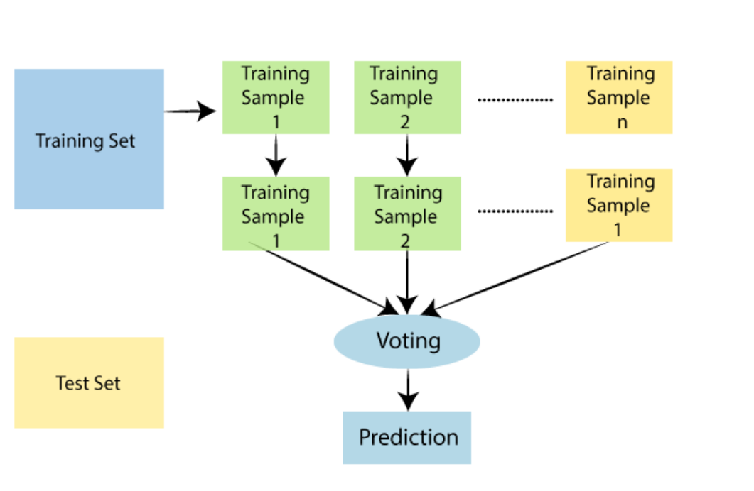
ALGORITHM
Random Forest algorithm
Random Forest is a supervised machine learning algorithm that uses a group of decision tree models. It can be used for both Classification and Regression problems in ML.

Slide 15
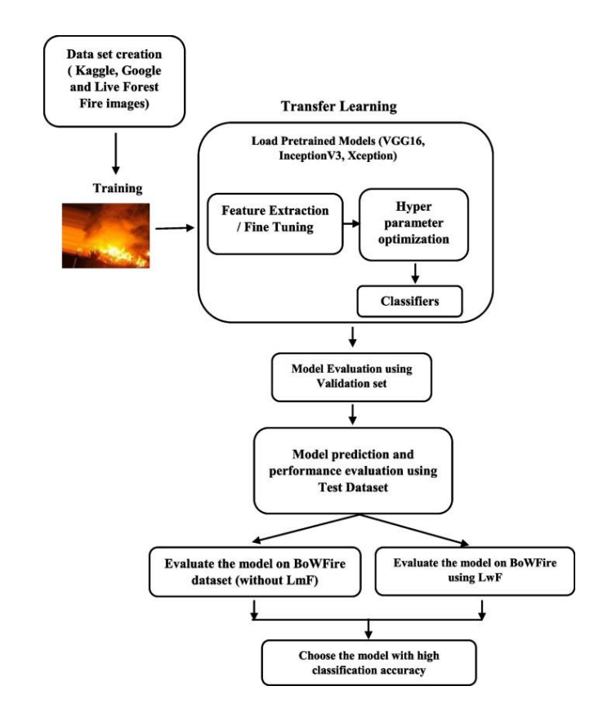
SYSTEM ARCHITECTURE

Slide 16
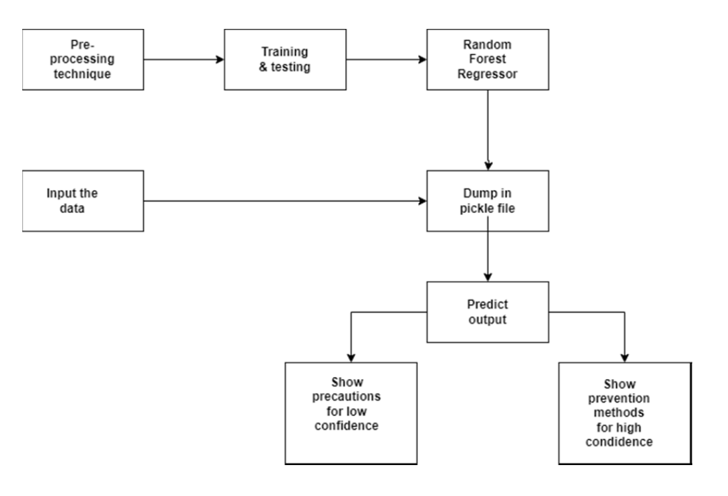
METHODOLOGY

Slide 17
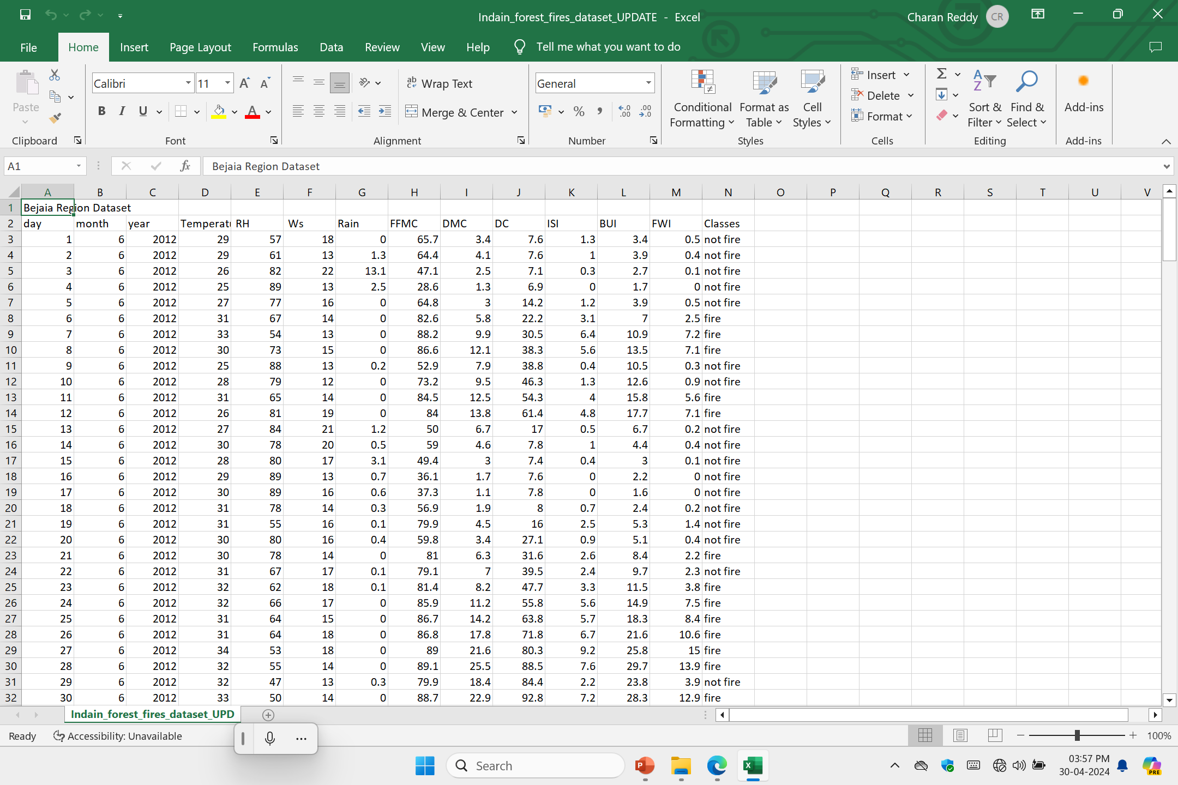
DATA SET

Slide 18
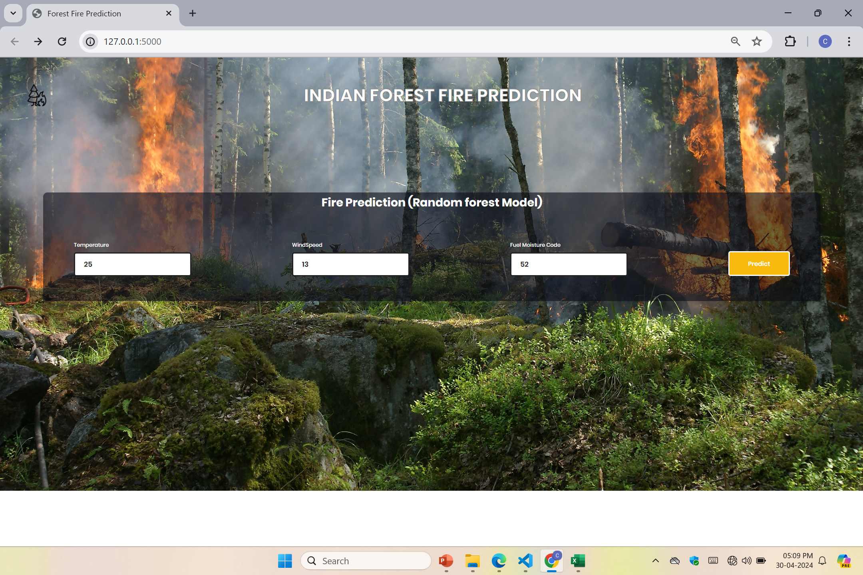
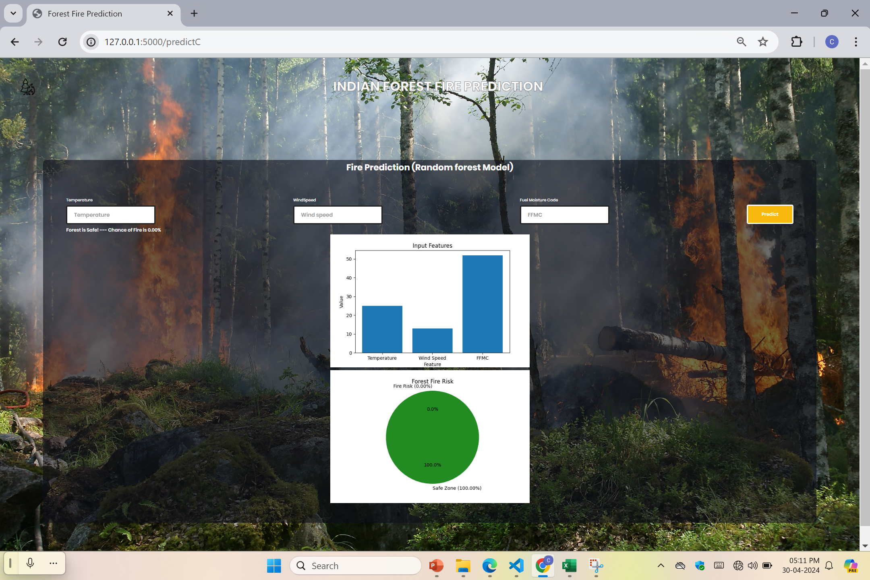
OUTPUT
USER INPUT
OUTPUT

Slide 19
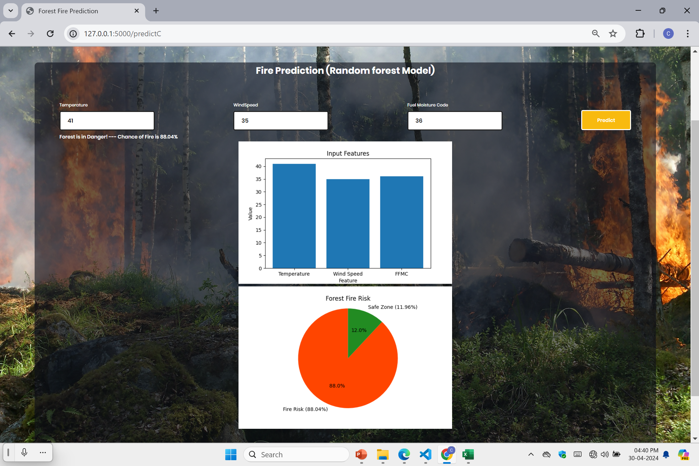
OUTPUT

Slide 20
CONCLUSION
In conclusion, the provided Flask web application demonstrates the use of machine learning techniques for forest fire risk prediction. The application utilizes a pre-trained classification model to predict the risk of a forest fire based on input features such as Temperature, Wind Speed, and FFMC (Fine Fuel Moisture Code).
These visualizations can aid in better understanding and interpreting the results, making the application more user-friendly and informative.
The web framework and the integration of various Python libraries, such as NumPy, Pandas, and Matplotlib, demonstrate the versatility and power of Python in building end-to-end machine learning solutions.
Overall, this Flask application showcases the practical application of machine learning techniques in addressing real-world challenges, such as forest fire risk prediction.

Slide 21
FUTURE SCOPE
Model Improvement
Real-time Data Integration
Geospatial Visualization
Scalability and Deployment
User Interface Enhancements

Slide 22
LITERATURE SURVEY
The main aim of Prediction of forest fire expected to reduce the collision of forest fire in the future.
The forest fires that are occurring in the forest region or wild land and are uncontrolled fires and cause significant and more damage to human and natural resources, which are one of the most dangerous disaster to the ecological environment .
Nowadays, Forest fires became one of the major important problems that cause huge damages to several areas around the globe.

Slide 23
REFERENCES
Cortez, P., & Morais, A. D. (2007). A data mining approach to predict forest fires using meteorological data. Proceedings of the 13th Portuguese Conference on Artificial Intelligence (EPIA 2007), 512-523.
Rodrigues, M., & de la Riva, J. (2014). An insight into machine learning algorithms to model human-caused wildfire occurrence. Environmental Modelling & Software, 57, 192-201.
Sayad, Y. O., Mousannif, H., & Al Moatassime, H. (2019). Predicting forest fire risk using wavelet transform and fuzzy neural networks. Journal of Theoretical and Applied Information Technology, 97(5), 1478-1488.
Vakalis, D., Sarimveis, H., Kiranoudis, C. T., Alexandridis, A., & Bafas, G. (2004). A GIS based operational system for wildland fire crisis management II. System architecture and case studies. Applied Mathematical Modelling, 28(4), 411-425.
Dlamini, W. M. (2010). A Bayesian belief network analysis of factors influencing wildfire occurrence in Swaziland. Environmental Modelling & Software, 25(2), 199-208.
Pourtaghi, Z. S., Pourghasemi, H. R., Aretano, R., & Semeraro, T. (2016). Investigation of general indicators influencing on forest fires and its prediction by random forest machine learning technique. Journal of Forest Research, 27(4), 805- 81.

Slide 24
THANK YOU

